Slide 1
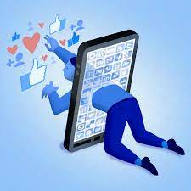
KBXY Research Study
KBXY Research Study
November
2021
Prepared by:
Keanan Anderson, Britt Pursell, Yue Qiu, Xinyuan Hu
November
2021
Prepared by:
Keanan Anderson, Britt Pursell, Yue Qiu, Xinyuan Hu

Slide 2
Agenda
Introduction/Overview
Case Situation
Purpose
Method
Exploratory Research
Descriptive Research
Findings
Section one- Univariate Analysis
Section Two – Multivariate Analysis
Conclusions and Recommendations

Slide 3
Overview
KBXY Marketing Group identified a target market of age 18-22-year-old full-time college students and how social media impacts their overall mental health. The overall perception of social media on students’ mental and social health has been ever evolving. Through the COVID-19 pandemic an increase in social media usage has become apparent across the board. With 84 % of adults (18-34) using social media daily to overall growth in individual app’s usage (Mintel). According to Hong et al, there is a positive correlation between social media exposure (SME) and psychological distress in college students. With an increase in social media usage and more positive correlations between SME and mental health, it provides a direct link to identify the impacts of social media on students’ mental health.

Slide 4
Purpose
Actively investigate the impacts of social media on mental health
Prepare recommendations for reducing negative impacts
Promote healthier lifestyles for interacting with social media

Slide 5
Exploratory Research
Xinyuan

Slide 6
Method — Exploratory Research
Secondary Data
The primary source of second-hand data comes from the library service database. The main sources include data resources and authoritative research articles.
Observation
We deduce through personal interviews that social media tends to have a negative impact on respondents’ attention and productivity. Still, respondents have different opinions on emotions related to positive and negative thoughts (laughter, happiness, anxiety, bad).
Personal Interviews
We found that the observers are easily distracted or inattentive due to social media/smartphones in the classroom during the observational data collection process. In the observed participant data collection, phone use was mainly in the morning and free time. It is also important to note that the use of telephone and social media are separate entities.
Reviewing the general findings from secondary data, observations, and interviews, we found that the use of social media/smartphones led to an overall decrease in attention, productivity, and emotions. Based on this result, we created five research questions.

Slide 7
Secondary Research Findings
91% of College Students use social media every day
46.2% have GPA within 1-1.5
62% of 16-24 year olds say smartphone would be the hardest device to give up
52.7% college undergrads felt hopeless, 67.3% felt lonely, 61.9% felt overwhelming anxiety, and 39.1% felt very depressed
89% of college students use Youtube, Facebook, and Instagram

Slide 8
Primary (Interview) Research Findings
Social media can be a good tool for development
Without being used properly, social media is a detriment to mental development
Majority stated that social media would reduve their ability to focus
Use of social media for an emotional response
Advertisements and entertainment play a large role in interactions with social media
Fear of missing out can cause decision making

Slide 9
Descriptive Research
Britt

Slide 10
Method - Descriptive Research
KBXY used a non-profitability sample survey that was directed at full-time enrolled college students ranging from ages 18-22. We used this form of research because of the ease of access to data collection methods. We reached out to college students through Instagram, Messages, Facebook, Snapchat, WhatsApp, and other group chats to efficiently collect a large sample size to conclude certain data points. We had 66 respondents over 4 days (10/26-10/29). An included sample survey framework was included so that we could reach out to our target population in order to pull our sample.

Slide 11
Survey
List of 20 questions
First 3 filtering
Age
Operating System
Full-time student
Consumer's Habits
What operating system (smartphone) do you use currently?
What do you primarily use social media for?
How often do you use your phone throughout the day?
How often do you use social media throughout the day?
How often do you check your phone during class?
Customer's Personality
How often do you use social media to stay in contact with friends, family, acquaintances?
Does social media help you make more in-person connections?
Do you feel that you need social media to “keep in touch” with your relationships?
Do you benefit from any of the following when using social media? Select all that apply.
General Opinion
Rate the social media apps in order from most used to least.
Does social media reduce your ability to focus?
What emotions do you associate with social media?
How likely are you to make a decision based on what you see on social media?
In what ways do you think social media impacts mental health? Select all that apply.
What emotions do you associate with social media?
Product attributes
“Social media negatively impacts mental health”

Slide 12
Univariate Analysis Categorical
Yue

Slide 13
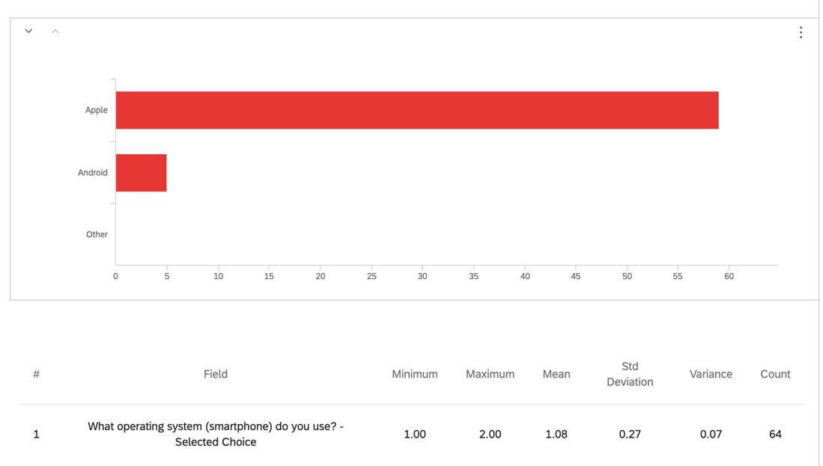
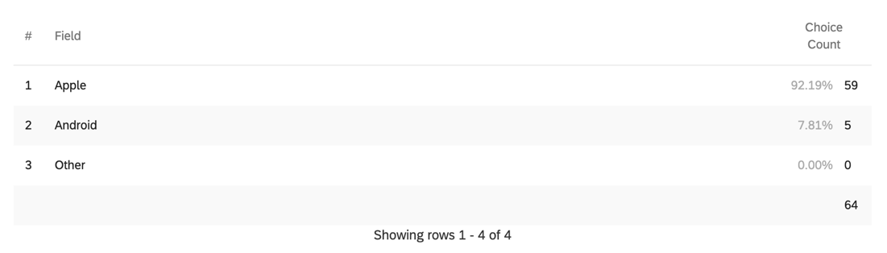
Operating System
Section One- Univariate Analysis- Categorical Measure
Operating System

Slide 14
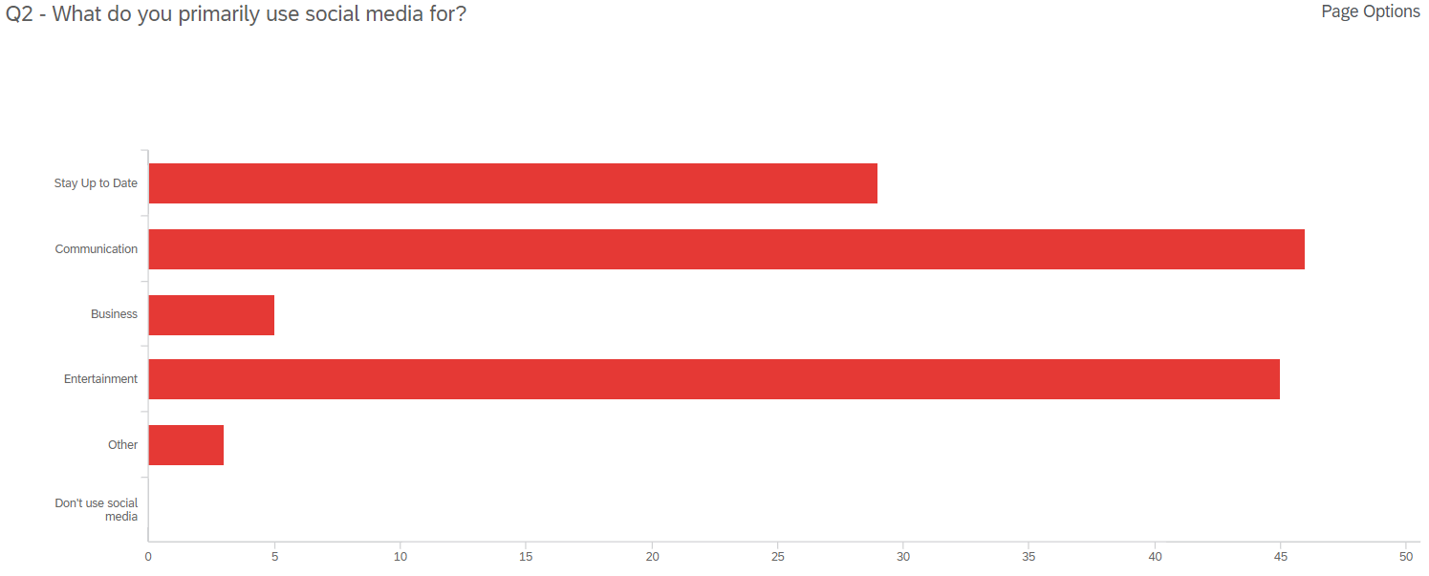
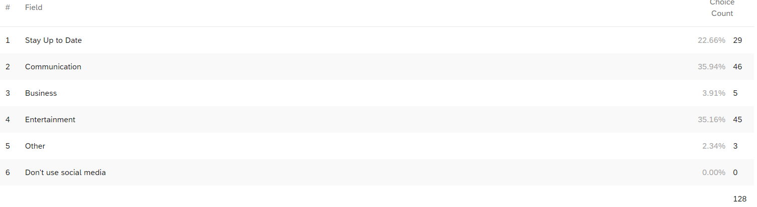

Usage of Social Media
Section One- Univariate Analysis- Categorical Measure
Usage of Social Media

Slide 15
Primary Social Media App
 | #1 | #2 | #3 | #4 | #5 | #6 | #7
Instagram | 8 | 22 | 39 | 4 | 0 | 6 | 0
Snapchat | 13 | 16 | 15 | 12 | 15 | 0 | 14
Twitter | 1 | 4 | 9 | 32 | 40 | 54 | 21
TikTok | 6 | 22 | 18 | 16 | 35 | 0 | 0
Facebook | 0 | 0 | 9 | 48 | 40 | 42 | 28
GroupMe | 0 | 0 | 9 | 24 | 35 | 78 | 35
WeChat | 6 | 4 | 3 | 0 | 5 | 24 | 14
Section One- Univariate Analysis- Categorical Measure
Primary Social Media App

Slide 16
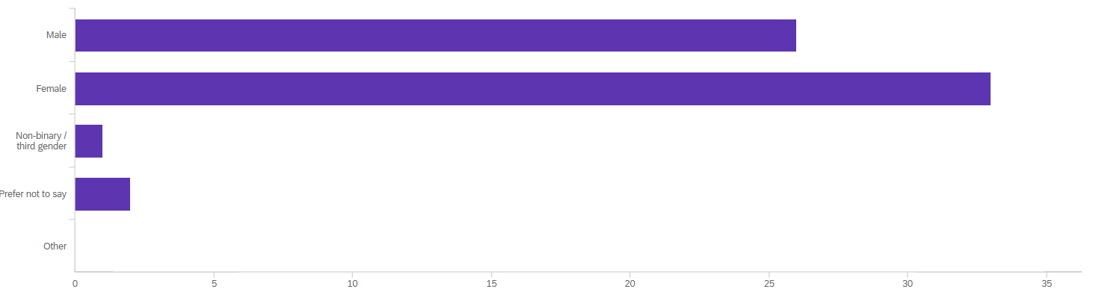
Gender
Section One- Univariate Analysis- Categorical Measure
Gender

Slide 17
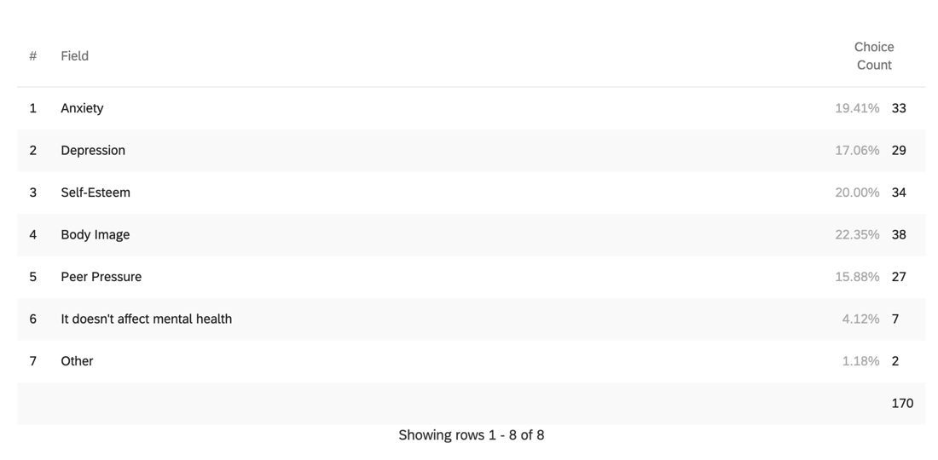
Negative Effects of Social Media
Section One- Univariate Analysis- Categorical Measure
Social Media Negative Effects

Slide 18
Univariate Analysis Continuous
Yue

Slide 19
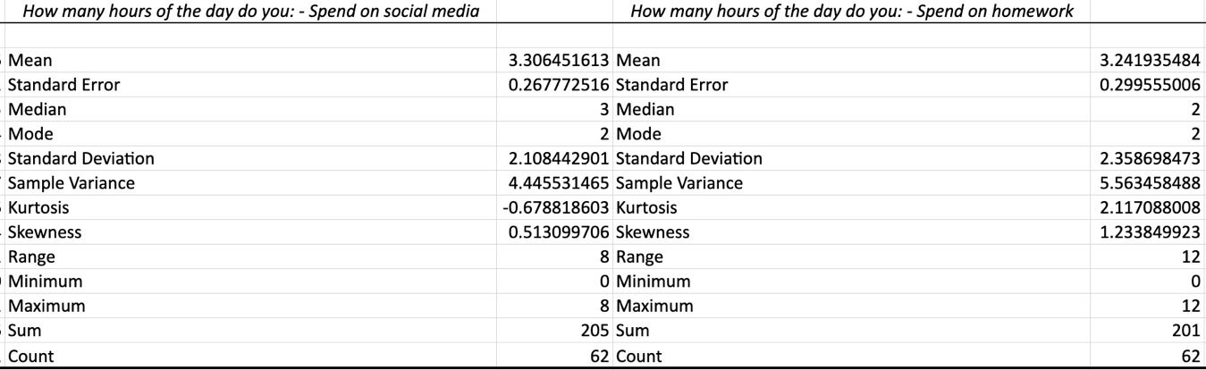
Hours Spent
Section One- Univariate Analysis- Continuous Measure
How many hours of the day on social media / homework

Slide 20
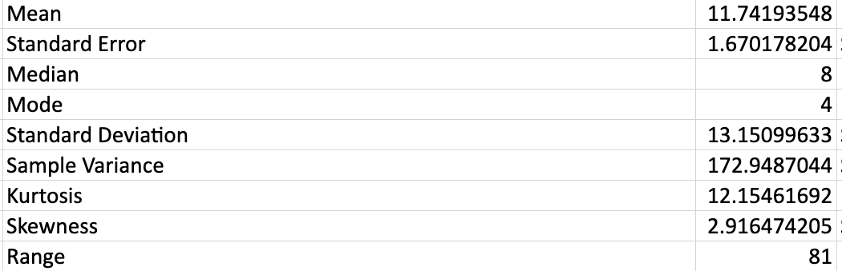
Check Phone During Class
Section One- Univariate Analysis- Continuous Measure
How many times do you check your phone during class

Slide 21
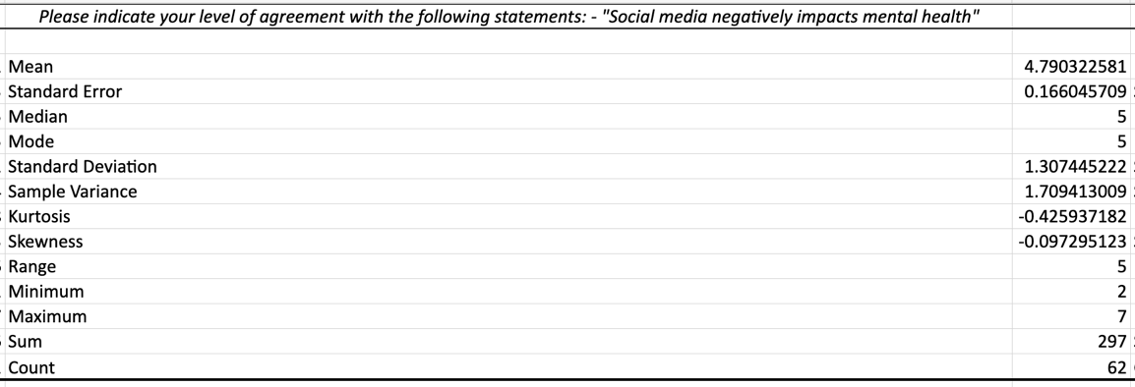
"Social Media Negatively Impacts Mental Health"
Section One- Univariate Analysis- Continuous Measure
“Social media negatively impacts mental health”

Slide 22
Multivariate
Keanan

Slide 23
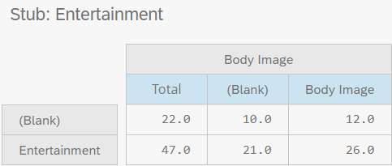
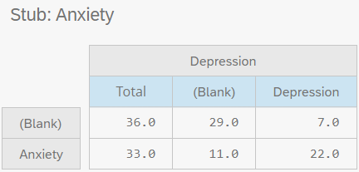
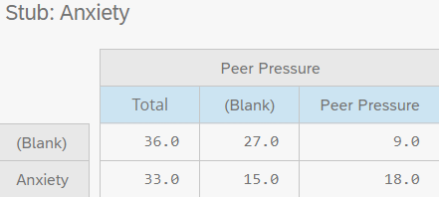
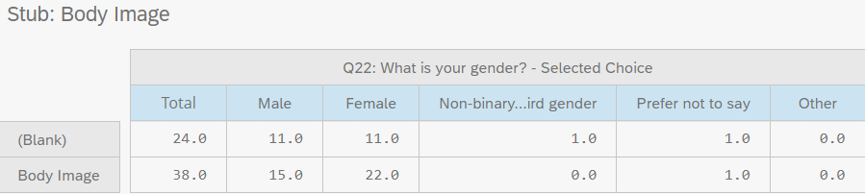
Crosstabs
Anxiety & Peer Pressure
P-Value: .012
Entertainment & Body Image
P-Value: .95
Anxiety & Depression
P-Value: .00007
Body Image & Gender
P-Value: .479

Slide 24
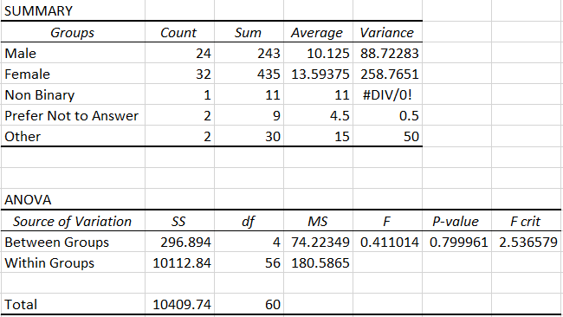
ANOVA Pt.1
Gender (Categorical) vs. Checked Phone During Class (Continuous)
Large variance within selections
Gender is not a good predictor of usage of phone during class

Slide 25
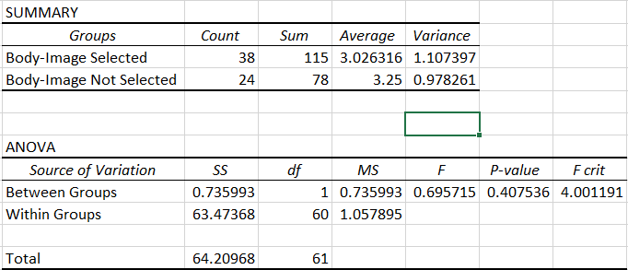
ANOVA Pt.2
Body Image vs. Likelihood to decide based off of Social Media
Large variance within selections
Body Image is not a good predictor of decision making

Slide 26
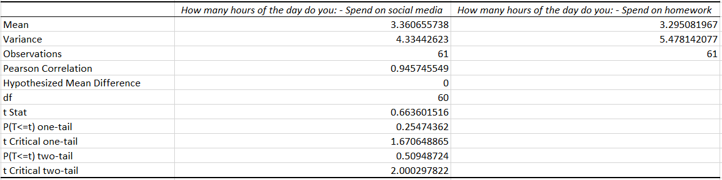
T-Test Pt.1
Hours spent on social media vs. Hours spent on homework
Not a significant difference
Social Media & Homework close in value
One-tail vs. Two-tail

Slide 27
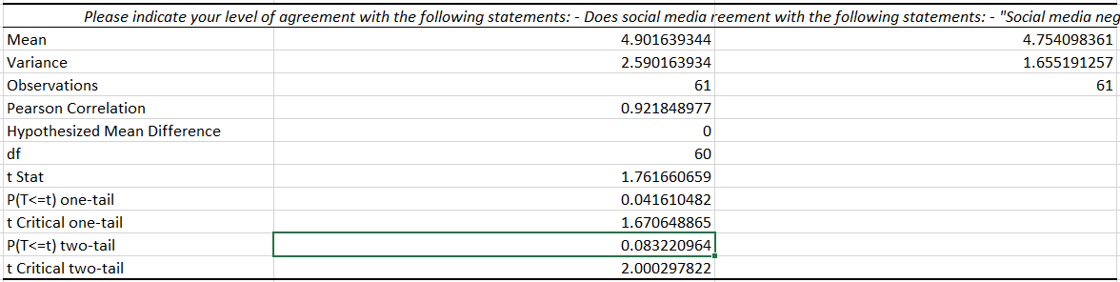
T-Test Pt.2
Social Media negatively impacts mental health vs. Reduces ability to focus
Matrix levels
1-7 disagree to agree
One-Tail is significant
Two-tail is not significant

Slide 28

Conclusion & Recommendations

Slide 29

Conclusions
Negative perceptions of social media
Positive perceptions of social media
Reduced focus
Phone & Social Media Usage

Slide 30

Recommendations
Imitate
Imitate TikTok "wellness check-ins"
Primarily on most used (Snapchat, Instagram)
Promote
Promote phone usage trackers
Encourage
Encourage use of breaks
Advance
Advance Mental Health Services Apps
Provide
Provide more specific research pursuits
Conduct
Conduct more research

Slide 31
References
Altalová, K. (2021). The influence of social media and hyperconnectivity on student academic productivity and performance (Pg. 35-59). https://dspace.cuni.cz/handle/20.500.11956/148034
Anderson, M., & Jiang, J. (n.d.). Teens, Social Media & Technology 2018 | pew research center. Public Services Alliance. Retrieved October 13, 2021, from https://publicservicesalliance.org/wp-content/uploads/2018/06/Teens-Social-Media-Technology-2018-PEW.pdf.
Cain, J. (2018, September 1). It's time to confront student mental health issues associated with smartphones and social media. American Journal of Pharmaceutical Education. Retrieved October 13, 2021, from https://www.ajpe.org/content/82/7/6862.
Lerman, K., Gallegos, L., Kumaraguru, P., & Arora, M. (2015, October). (PDF) social ties and emotions: Evidence from Social Media. ResearchGate. Retrieved October 13, 2021, from https://www.researchgate.net/publication/283279804_Social_Ties_and_Emotions_Evidence_from_Social_Media.
Moss, A. (n.d.). Database access . Libraries Database Access. Retrieved October 13, 2021, from https://reports-mintel-com.du.idm.oclc.org/display/915632/?fromSearch=%3Fdate%3D1551484800000%26freetext%3Dimpact%2520of%2520social%2520media%2520on%2520mental%2520health%26sortBy%3Drecent%26view%3Dlist.
Pew Research Center. (2021, April 26). Demographics of social media users and adoption in the United States. Pew Research Center: Internet, Science & Tech. Retrieved October 7, 2021, from https://www.pewresearch.org/internet/fact-sheet/social-media/?menuItem=c14683cb-c4f4-41d0-a635-52c4eeae0245.
Radovic, A., Gmelin, T., Stein, B. D., & Miller, E. (2016, December 18). Depressed adolescents' positive and negative use of social media. Journal of Adolescence. Retrieved October 13, 2021, from https://www.sciencedirect.com/science/article/abs/pii/S0140197116301713?casa_token=Zxt4kaA17UoAAAAA%3AJhqKOM615SBdPN6iIxuucq6OU7_Nwq_l2o1zcqdhCS-0FvE-4XmvAGAfNvc9pTY9ewXGb6aSzT8M.
Wei Hong, Ru-De Liu, Yi Ding, Xinchen Fu, Rui Zhen, and Xiaotian Sheng. Cyberpsychology, Behavior, and Social Networking. Apr 2021.282 287.http://doi.org/10.1089/cyber.2020.0387

